Slide 1
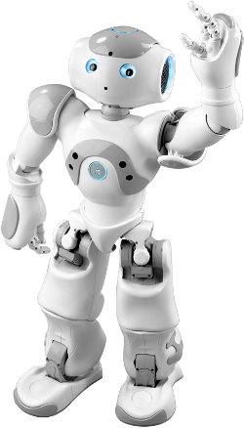
Nao by Nao
An introduction to robotics
Notes:
# initial standing pose
{behavior|StandHead}
\pau=3000\
# Slide 1.
{behavior|HelloEverybody}
Welcome everyone! \pau=500\ Good afternoon!
\pau=200\
{behavior|Intro}
{behavior|LegRandomMove}
My name is Robo Tutor. \pau=300\ Today I will be giving a lecture to you.
{behavior|HandOverLeft}
In this lecture I will present an introduction to robotics.
{behavior|MeAndYouLeft}
{behavior|LegRandomMove-500-0.8-500}
I will mostly be explaining to you about myself, \pau=300\and my fellow NAO robots.
{behavior|SpreadBoth}
The goal is to give you a general overview about how we work.

Slide 2
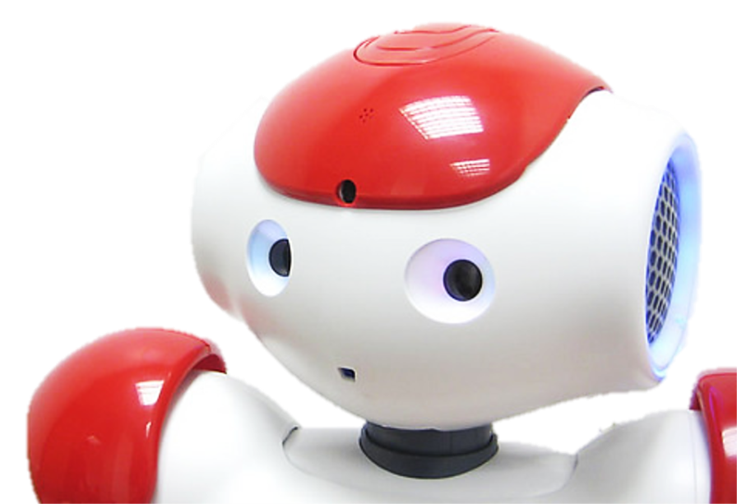
Overview
Introduction to Robotics
Sensors of NAO
Effectors of NAO
Programming a NAO
Applications – Robotutor
Notes:
# slide 2
{behavior|Twinkle}
{slide}
\pau=1000\
{behavior|FirstMe}
{behavior|LegRandomMove-500-0.8-500}
I will start with telling you a few basic things about robotics, and what kind of jobs we might be able to do for you.
{behavior|MeAndYouLeft}
{behavior|LegRandomMove-500-0.8-500}
Then I will use myself as an example to introduce common sensors, and effectors of a robot to you.
{behavior|PushAside}
I will also say a few things about, how you can write programs for controlling my behavior.
{behavior|HandOverLeft}
{behavior|LegRandomMove}
Finally, I will present an approach that, enables me to navigate in a hallway of the building that we are in.
{behavior|PressDown}
{behavior|LegRandomMove}
This is a common task for robots in general but quite a challenge for humanoids like me.
{behavior|PointForward}
Throughout this presentation, I will ask you some quiz questions. So please pay attention.
\pau=300\
{behavior|HandOver}
You should all have a turning point clicker.
\pau=300\
{behavior|LegRandomMove-500-0.8-500}
Please use this to answer the questions I present on the slides.

Slide 3
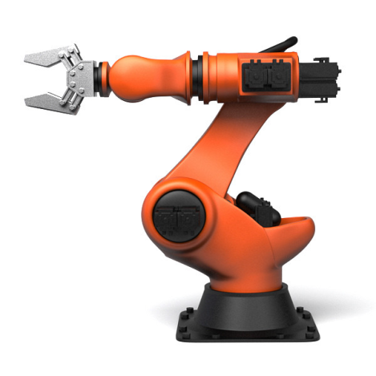
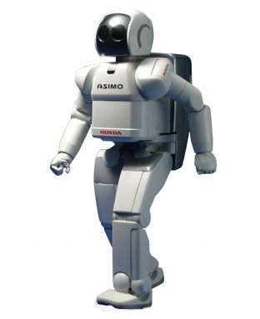
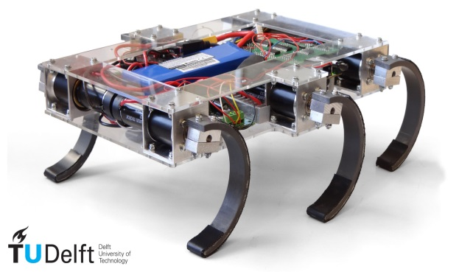
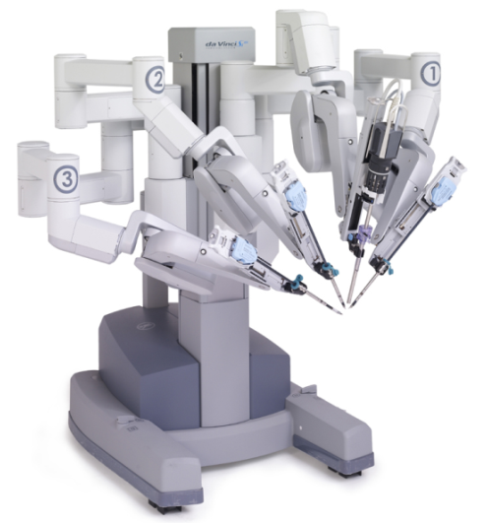
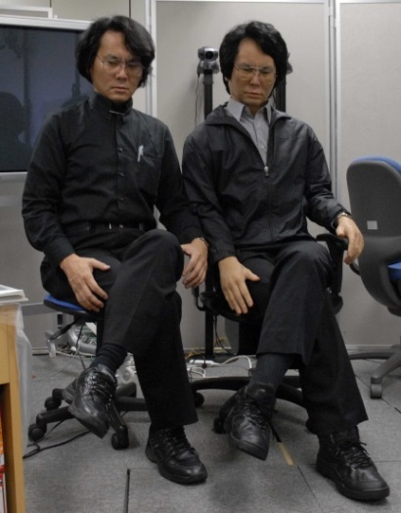
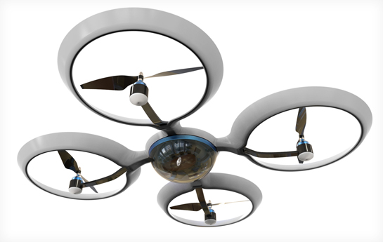
My (distant) robot family
KUKA
Asimo
Zebro
DaVinci
Quadcopter
Geminoid
Manipulators
Mobile Robots
Humanoids
Notes:
# Slide 4
{behavior|Twinkle}
{slide}\pau=1000\
{behavior|Me}
{behavior|LegRandomMove}
Let me introduce you to some of the more well-known members of my robot family.
{behavior|HandOverBoth}
I will show some more robot relatives of mine on the next slide.
\pau=500\
{behavior|Balance}
Manipulators are my most distant family members. They are physically anchored to their workplace.
{behavior|PointUpRight}
{behavior|LegRandomMove}
At the top left you see a typical assembly robot, the KUKA manipulator.
{behavior|FromAToB}
{behavior|LegRandomMove}
These robots are used to assemble many items, from cars to computers.
{behavior|No}
{behavior|State}
{behavior|LegRandomMove}
They do not have much intelligence, they just do as they are told in some sort of preprogrammed script.
\pau=500\
{behavior|HandOver}
{behavior|LegRandomMove}
On the left bottom, you see the doctor of the family, Da Vinci.
{behavior|ConvergeHands}
He works together with a human doctor or surgeon to perform many difficult surgeries.
{behavior|Capisce}
{behavior|LegRandomMove}
DaVinci is a high precision robot which makes surgeries a lot easier for doctors.
\pau=500\
{behavior|State}
Next to KUKA, you see the Ze-bro robot developed at Delft University.
{behavior|WavyShape}
{behavior|LegRandomMove}
Ze-bro is a member of the family of mobile robots and can move on rough terrain.
{behavior|Convince}
It is a very robust robot that can survive a fall of several meters.
\pau=500\
{behavior|PointFrontDown}
{behavior|LegRandomMove}
At the bottom, in the middle, you see a quadcopter that is a flying member of the mobile robot family.
{behavior|PushAsideBoth}
They are commonly used for surveillance.
\pau=500\
{behavior|ShowSideLeft}
To the right of Ze-bro you see Honda Asimo, my big brother.
{behavior|LegRandomMove}
Asimo is widely known for its abilities to walk up stairs, \pau=300\ jump,
{behavior|SpreadBoth}
and perform many jobs around the house.
{behavior|Balance}
He also appeared in the movie, Robot and Frank.
\pau=1000\
{behavior|SpreadLeft}
At the right bottom, you see a human sitting with a robot.
{behavior|Think}
{behavior|LegRandomMove}
Can you guess which is the robot?
\pau=1000\
They look quite similar, even indistinguishable if they do not move.
\pau=1000\
{behavior|State}
Robots like this are called Geminoid robots.
\pau=500\
{behavior|ConvergeHands}
These are just some of the many examples of robots in every day life.

Slide 4
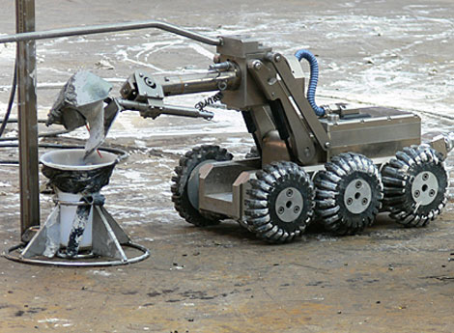
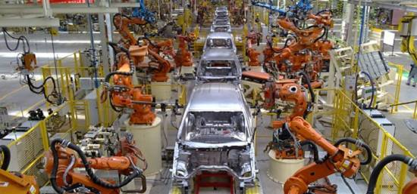
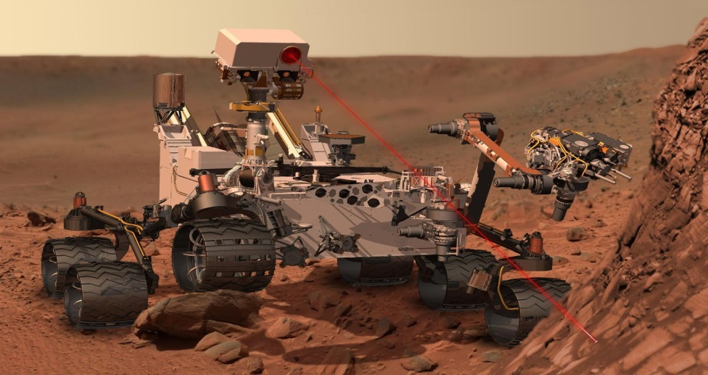
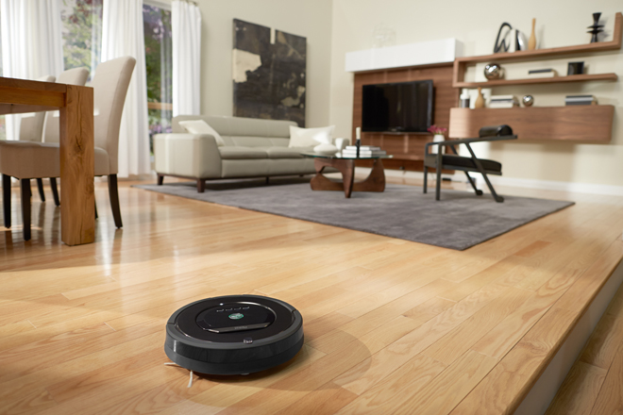
Why do you need us robots?
Tasks dangerous for humans
Repetitive, mechanical tasks
Exploration tasks
Service tasks
Notes:
# Slide 5
{behavior|Twinkle}
{slide}\pau=1000\
{behavior|RotatingCapisce}
{behavior|LegRandomMove}
So originally we are meant to serve you. But for what tasks can you put us to good use?
{behavior|Motivate}
I probably should make a good case here to convince you that I am worth the money.
{behavior|YouAndMe}
{behavior|LegRandomMove}
Unlike humans, we robots are not affected by fear, and we are able to help with dangerous tasks that you would rather not.
{behavior|Propose}
{behavior|LegRandomMove}
Take for example the nuclear disaster in Fukushima. Robots were used to clean up the nuclear waste.
{behavior|HandOver}
{behavior|LegRandomMove}
Unlike humans we robots also have no problem performing repetitive tasks like boxing items
{behavior|ConvergeHands}
and putting things together.
{behavior|LegRandomMove}
For example, all cars produced today are assembled by robots.
{behavior|PushAsideBoth}
In many assembly line tasks, we robots have become more cost-effective than human workers.
{behavior|PushAsideBoth}
{behavior|LegRandomMove-500-0.8-500}
We are also becoming very effective tools for gathering information in domains that are difficult (or dangerous) for people to access.
{behavior|No}
Without robots you would not have explored Mars!
# more and more
And last but not least we are also
{behavior|PushAsideBoth}
becoming more and more able to assist individuals in performing daily tasks.
{behavior|SpreadLeft}
For example, you can buy my relative called the Roomba to vacuum clean your house.
{behavior|Applaud}
It can even detect filthy areas that need more cleaning.

Slide 5
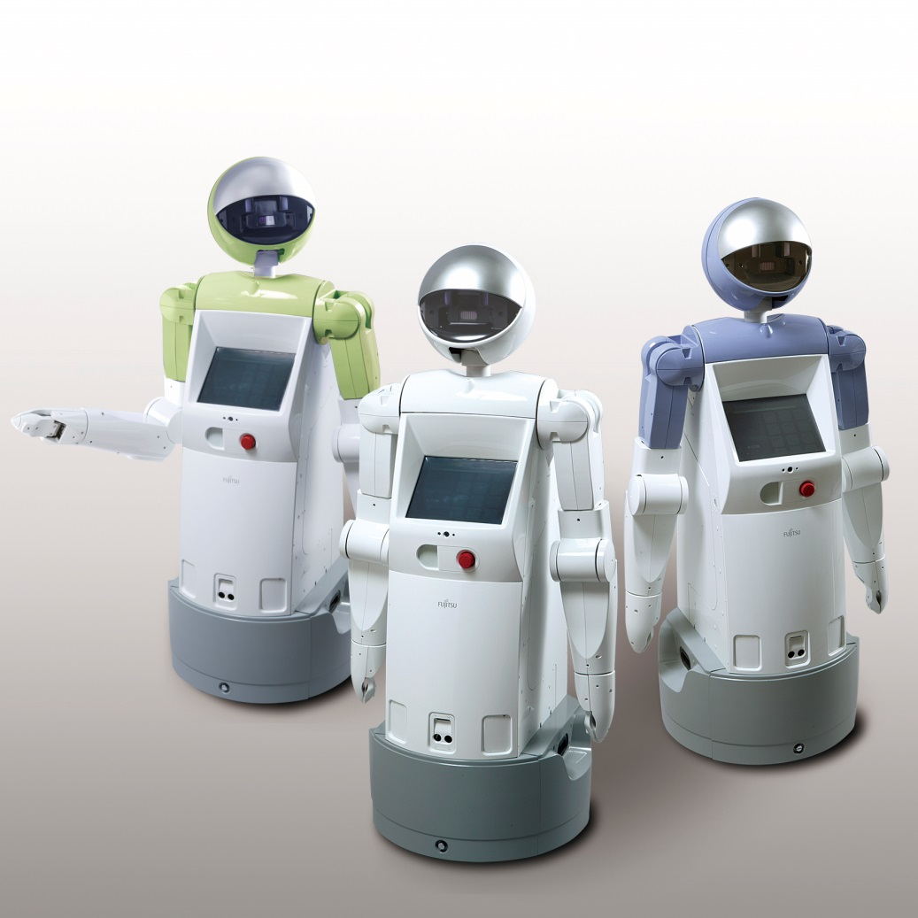
What is a robot?
A robot is:
Physical Agent
Manipulates the physical world
Has sensors
Has effectors
Notes:
# slide 6
{behavior|Twinkle}
{slide}\pau=1000\
{behavior|ConvergeHands}
{behavior|LegRandomMove}
Let's now try to define what a robot is.
\pau=1000\
{behavior|Me}
As you will have noticed I am a robot. Because I have \rmw=1\legs, arms\rmw=0\
{behavior|ShowBody}
and a body that looks a bit like a human, \pau=500\I am a humanoid robot.
Although we most of the time,
{behavior|SpreadBoth}
{behavior|LegRandomMove}
all will agree on seeing a robot when we see one, providing a definition that we all agree on,
{behavior|No}
is not so easy.
\pau=1000\
{behavior|Capisce}
{behavior|LegRandomMove}
Russell and Norvig define robots as, "physical agents that perform tasks by manipulating the physical world."
{behavior|LegRandomMove}
To this end, robots are equipped with effectors and sensors.
{behavior|SpreadBoth}
{behavior|LegRandomMove-500-1.2-800}
One of the issues with a typical definition as this one, is that, some appliances that you might think, are not robots, technically are.
{behavior|Think}
{behavior|LegRandomMove-500-1.2-800}
Imagine, for example, your home thermostat. It is a physical agent, also has sensors and effectors, and manipulates temperature in the physical world.
{behavior|PressDown}
But a thermostat clearly is something very different from a robot like me!
\pau=200\
{behavior|PushAsideBoth}
{behavior|LegRandomMove}
Up to now, there is no standard definition of robot that satisfies everyone, and many people have their own.

Slide 6
How do we work?
Sensor
Control Program
Effector
Notes:
# Slide 8
{behavior|Twinkle}
{slide}\pau=1000\
{behavior|FirstMe}
From now on, I will take myself as a leading example to explain to you in more detail
{behavior|OneTheOther}
about robot sensors and effectors.
{behavior|LegRandomMove}
I will also tell you something about creating a program to control me.
\pau=300\
{behavior|HandOverBoth}
I will give you an overview of the most common, and important aspects.

Slide 7
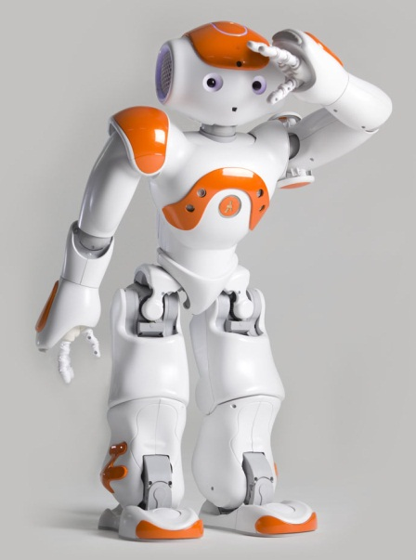
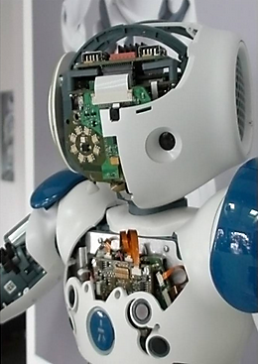
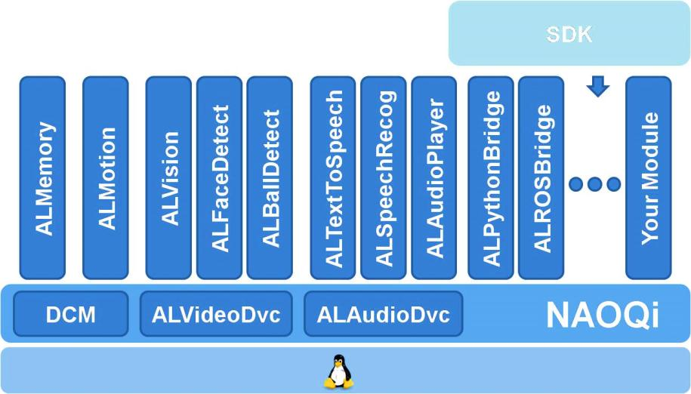
Humanoid Robot NAO
Humanlike appearance
Programmable, compact, electro-mechanical
Processor: Intel Atom Z530
Software
Linux System
Control Architecture: NaoQi Framework
(AL)Modules and self-built modules
Multi-language SDK
Notes:
# slide 9
{behavior|Twinkle}
{slide}\pau=1000\
{behavior|YouAndMe}
When you see a humanoid robot like me, you must be attracted by my elegant appearance.
{behavior|SmallBow}
{behavior|LegRandomMove-500-1.2-800}
But in fact, I am a programmable compact electromechanical system, equipped with sensors that capture states of my body and the world around me.
\pau=400\
{behavior|ConvergeHands}
{behavior|LegRandomMove}
All information gathered by my sensors is then processed
{behavior|MeLeft}
by my processors to decide what to do next.
{behavior|Capisce}
Based on this decision, I then use my effectors to manipulate objects or just move my limbs.
{behavior|RotatingCapisce}
{behavior|LegRandomMove}
To this end, a Linux system was tailored for me, to manage the data from various sensors, and schedule the control of effectors.
{behavior|LegRandomMove}
A framework called Nao Qi, which is a modular architecture, was designed to enable developers to build customized modules.
{behavior|Me}
One can also control me using SDK libraries. I will provide details later on.

Slide 8
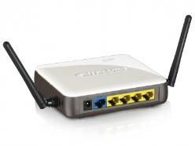
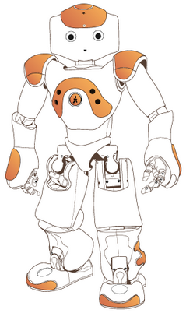

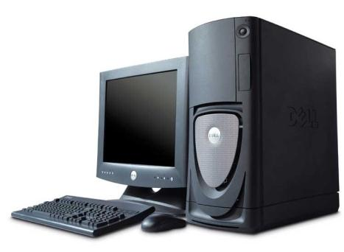
Remote and Local Control
Server
Client
Local vs. Remote
Trade-off
Computational power
Data transmission cost
Core i7 on the
desktop/laptop
Atom Z530
on the robot
Notes:
# slide 10
{behavior|Twinkle}
{slide}\pau=1000\
{behavior|HandOverLeft}
{behavior|LegRandomMove}
There are two main methods for controlling me.
{behavior|State}
One approach is to add a module on my Linux system, which then can be executed after I boot up.
{behavior|RotatingCapisce}
{behavior|LegRandomMove}
The other approach is probably more convenient for developers. That is to control me from a remote computer through Wi Fi or cables.
{behavior|You}
As you may know, a typical desktop or laptop computer
{behavior|Weigh}
{behavior|LegRandomMove}
has more computation power, than I have on board. Therefore, the execution of a complex algorithm
{behavior|Propose}
{behavior|LegRandomMove-500-0.8-500}
may take significantly more time on me, than on a separate computer. However, you also need to consider that transmitting data
{behavior|FromAToB}
from me to a computer also costs time.
{behavior|LegRandomMove-500-0.8-500}
For example, images may cost hundreds of milliseconds before they are transferred to the computer.
{behavior|LegRandomMove}
Thus, you will always need to make
{behavior|Weigh}
a trade off between running a module on me, or on a computer.

Slide 9
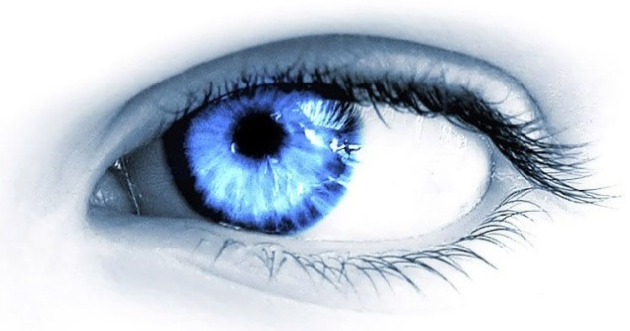
Sensors
Sensors
Perceive properties and events from environment
Color, shape, size of objects
A human is approaching the robot
Feedback on its own behaviors
Is the robot hand touching the cup?
Example sensors:
Gyroscope, thermometer,
laser sensor, camera, microphone,
etc.
infrared
camera
lasers
GPS
digital
compass
photoelectric
encoder
sonar
Notes:
# slide 11
{behavior|Twinkle}
{slide}\pau=1000\
# all
{behavior|PushAsideBoth}
All robots need some type of sensors to observe the world around them.
\pau=200\
{behavior|OneTheOther}
Some robots need more sensors than others.
\pau=200\
{behavior|LegRandomMove}
For example, the assembly robot of several slides ago, barely needs any sensors at all.
{behavior|SpreadLeft}
Humans however, already have more than 700 sensors.
{behavior|Tiny}
in one square inch of skin.
\pau=500\
{behavior|PressDown}
{behavior|LegRandomMove}
It also depends on the task. A robotic vehicle that has to navigate in a complex environment needs many sensors, as you can see on the right of the slide.

Slide 10
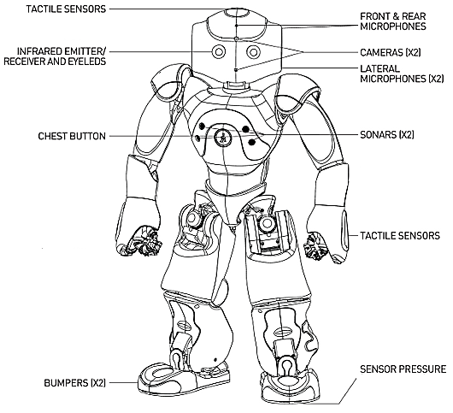
Sensors of NAO
Camera 2
Microphone 4
Sonar 2
Pressure 8
Tactile 9
Bumper 4
Button 1
Infrared 2
Accelerometer 1
Gyro 2
Joint Position Sensor 36
Current/Temperature Resistors 27
Notes:
# slide 12
{behavior|Twinkle}
{slide}\pau=1000\
{behavior|LegRandomMove}
{behavior|YouAndMe}
On the slide you can see what kind of sensors I have myself. I have 98 sensors in total.
{behavior|LegRandomMove}
Most of these sensors I need to function properly.
{behavior|No}
{behavior|LegRandomMove}
Do not look down upon the tiny resistors. For example, I have 27 tiny resistors that I use for detecting,
{behavior|OneTheOther}
both the current to the motors, and the battery. These current values
{behavior|LegRandomMove}
{behavior|Capisce}
are also used to, estimate the temperature of my joints and battery.
{behavior|You}
{behavior|LegRandomMove}
Now, I will introduce the more complex ones, in more details to you.

Slide 11
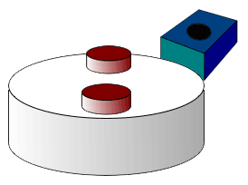
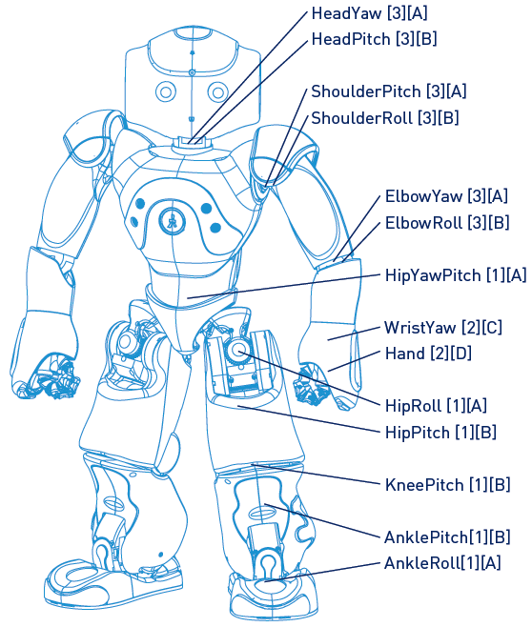
Sensor – Position sensors (Magnetic Rotary Encoder)
Detect the (angular) position of joints/motors
In the picture
Two equally spaced magnets
The output voltage peaks twice per revolution.
Notes:
# slide 13
{behavior|Twinkle}
{slide}\pau=1000\
# joints position sensor
{behavior|ShowBiceps}
The position sensors are the most frequently used sensors inside my body.
{behavior|RotatingCapisce}
They are used to detect the angles of the joint rotation.
{behavior|LegRandomMove}
The sensor detects the angular position of the permanent magnet.
{behavior|PointUpRight}
{behavior|LegRandomMove}
The top right picture illustrates a wheel, with two equally spaced magnets. The voltage from the sensor, will peak twice for each revolution.

Slide 12
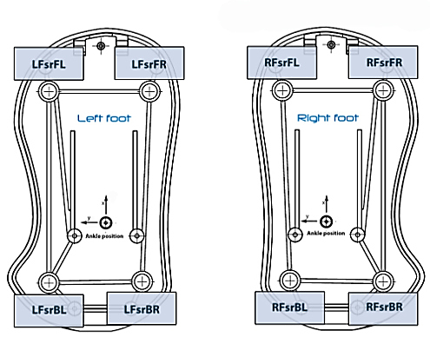
Force sensor - Force Sensitive Resistors
Detect whether the robot is standing on something
Force change -> Resistor value change
Walking balance
Fall-down detection
Notes:
# slide 14 pressure sensor
{behavior|Twinkle}
{slide}\pau=1000\
{behavior|LegRandomMove}
{behavior|State}
The force sensor utilizes a material, whose resistance changes, when a force or pressure is applied. I need them to check
{behavior|PushAside}
whether my feet are positioned correctly. They can be used to determine
{behavior|Balance}
whether I am balanced when I move my legs, and whether I am falling down. This information is also used
{behavior|Walk}
{behavior|SpreadLeft}
during the walk. At least one foot must maintain contact with the ground, otherwise I will stop walking.

Slide 13
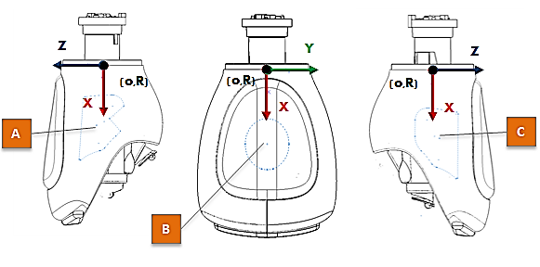
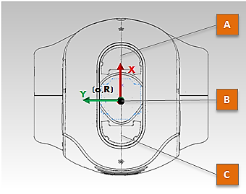
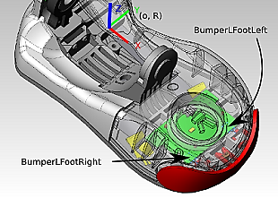
Tactile Sensors
Hand (3)
Left, Right, Back
Head (3)
Front, middle, back
Foot (2x2)
Left, right
Notes:
# slide 15 tactile
{behavior|Twinkle}
{slide}\pau=1000\
# tactile
{behavior|ShowMicLeft}
{behavior|LegRandomMove}
There are tactile sensors on my head and hands, to detect if someone is touching me.
The bumpers on the front of my feet act as collision sensors, to check if I bumped into something.
{behavior|tactileinteraction}
Hi, Koen. Could you check whether the tactile sensors on my head are working?
\pau=10000\
The sensors are working well! He just hurt my head!

Slide 14
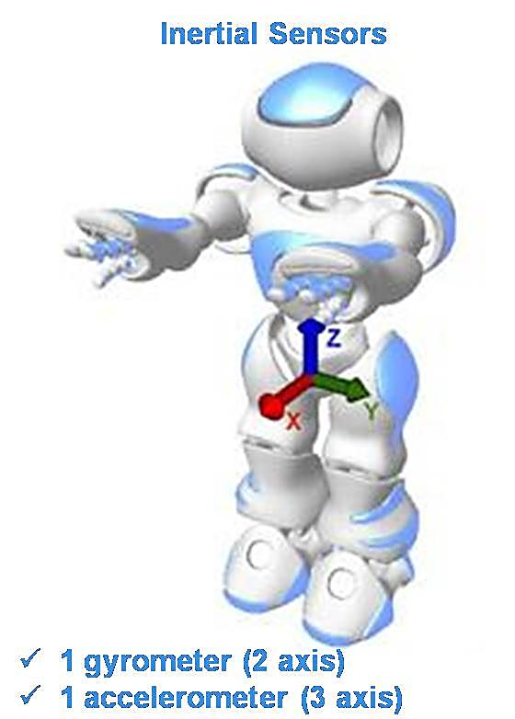
Inertial and Gyro sensors
Acceleration: x, y, z
Rotation: Roll (x), Pitch (y)
Tracking the robot position
Tracking the robot pose
Walking balance
Fall-down detection
Notes:
# slide 16
{behavior|Twinkle}
{slide}\pau=1000\
# inertial and gyro sensors
{behavior|Me}
{behavior|LegRandomMove-500-1.0-500}
I have inertial sensors that can track my position in real time based on the detected acceleration of my body.
{behavior|LegRandomMove-500-0.8-500}
The gyro sensors provide me information about my orientation.
{behavior|State}
Thus, I can determine my next step using this information.
{behavior|LegRandomMove}
Since these sensors are sensitive to acceleration, they are also used to detect whether I am falling down.

Slide 15
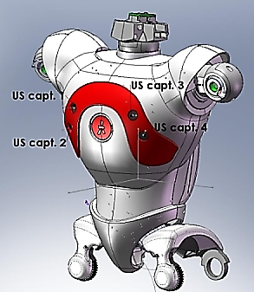
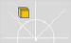



Sensor - Sonar
Emitter-receiver pairs ×2 on front
Resolution: 1cm
Effective cone: 60°
Detection Range: 0.25m to 2.55m
Obstacle detection
Pros: Fast
SonarLeft
Detected
SonarRight
Detected
SonarLeft
NothingDetected
SonarRight
NothingDetected
Events:
Notes:
# slide 17 sonar
{behavior|Twinkle}
{slide}\pau=1000\
# sonar
{behavior|ShowChest}
{behavior|YouAndMe}
{behavior|LegRandomMove-500-0.8-500}
On my chest, I have two sets of sonar sensors to approximate the distance between me and objects in front of me, and to roughly estimate the position of the objects,
{behavior|LegRandomMove-500-0.6-500}
as you can see in the pictures on the bottom of the slide.
{behavior|HandOver}
The sensor contains an emitter which sends out the ultrasonic wave, and a receiver
{behavior|Me}
which receives the ultrasonic wave rebound from obstacles.

Slide 16
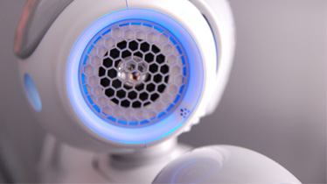
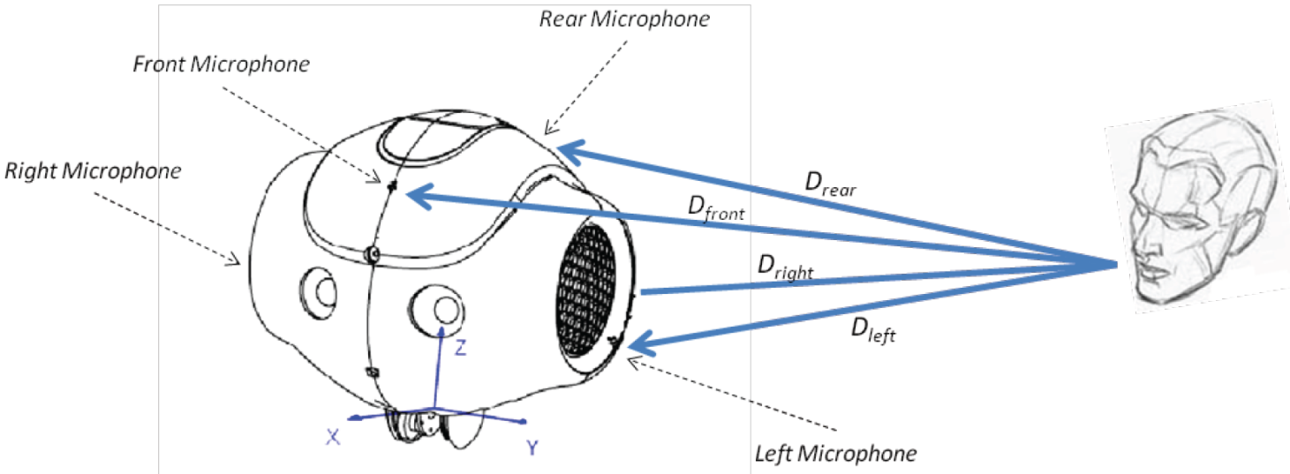
Sensor - Microphone
4: front, rear, left, right
Speech recognition
Match predefined words
Cannot recognize undefined words
Audio source localization
Notes:
# slide 18 microphone
{behavior|Twinkle}
{slide}\pau=1000\
{behavior|LegRandomMove}
Like how you use your ears to listen,
{behavior|ShowMic}
I have 4 microphones located on my head to do the same. I can localize the sound source,
{behavior|OneTheOther}
{behavior|LegRandomMove}
and determine whether the words I hear match the words I expect.
{behavior|HandOver}
As you can see the in the picture at the bottom,
{behavior|RotatingCapisce}
{behavior|LegRandomMove}
{behavior|LegRandomMove-800-0.5-0}
the different distances that the sound waves need to travel, induce time differences of arrival, which are measured and used to compute the current position of the source.

Slide 17
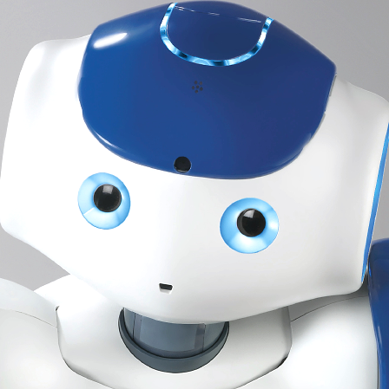
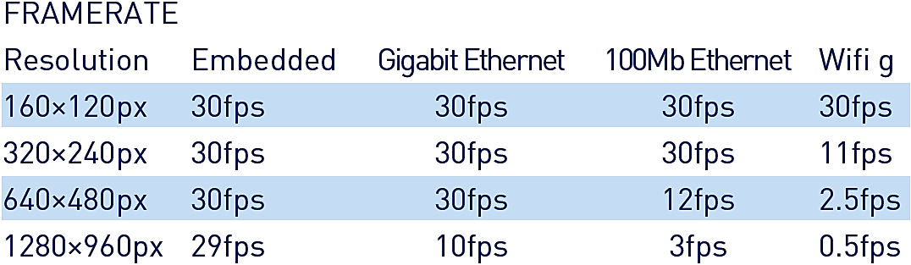
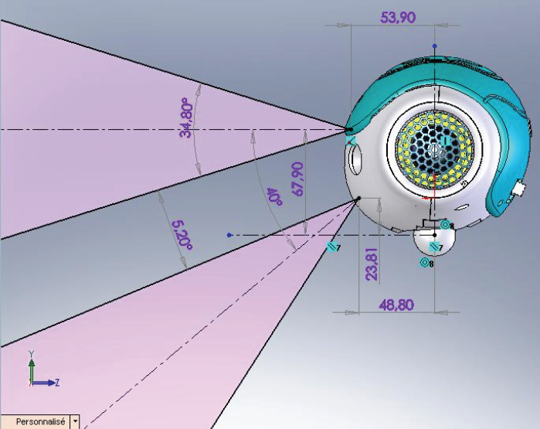
Sensor - Camera
Number×2 on front
Active Pixels 1288×968
Frame Rate
Non-overlapped field of View
Focus Range: 30cm ~ infinity
Notes:
# slide 19 camera
{behavior|Twinkle}
{slide}\pau=1000\
# camera
{behavior|YouAndMe}
Similarly to how you use your eyes to see, I use two cameras which I can use to see you.
Although the resolution of
{behavior|MeAndYou}
{behavior|LegRandomMove}
my eyes is much less than your eyes, I can still recognize many things with the help of computer vision algorithms.
However, the field of view of my cameras
{behavior|No}
{behavior|LegRandomMove}
does not overlap, so 3D vision algorithms cannot be applied to me directly.
{behavior|State}
Fortunately, my developers have invented a method for stereo vision, by using two images
{behavior|LookAround}
taken at different perspectives by one of my cameras.
\pau=1000\
# photo
{behavior|First}
{behavior|LegRandomMove}
Now, I will take a photo of you, using the camera on my forehead, and put it on the slide, to show, how my camera works.
# head pose for taking a photo
{behavior|PhotoHeadPose}
It takes some time, to create the slide.
\pau=1000\
# Take a photo
{show image}
\pau=5000\
# head pose back
{behavior|StandHead}
Almost done.
{slide}
\pau=1000\
{behavior|You}
{behavior|LegRandomMove}
You there, on the front, \pau=300\ you weren't sleeping, were you?
\pau=2000\

Slide 18
Overview
Introduction to Robotics
Sensors of NAO
Effectors of NAO
Programming a NAO
Applications – Robotutor
Notes:
# Slide 1.
{behavior|HelloEverybody}
Hello everyone! \pau=500\ Welcome back!
\pau=200\
{behavior|LegRandomMove}
{behavior|FirstMe}
In the first part, I introduced some basic concepts of robots, and sensors.
{behavior|LegRandomMove}
Now I will talk about effectors, programming, and applications.

Slide 19
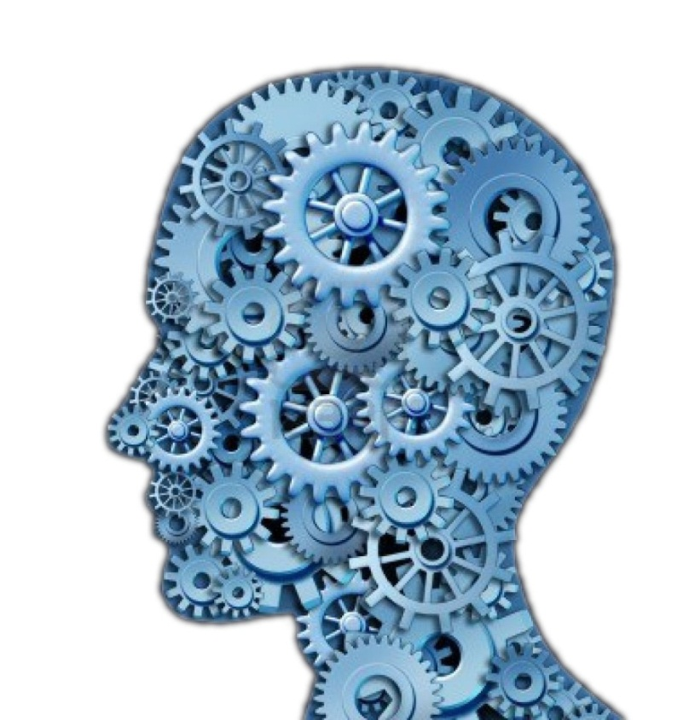
Processing - from input to output
Examples:
Processing maps input (sensor data) to output (actuator control).
State extraction (localization & navigation)
Computer Vision for understanding images
Sensor Fusion for a sense of motion
Notes:
# slide 23 Processor
{behavior|Twinkle}
{slide}\pau=1000\
{behavior|YouAndMe}
Sensors give you, and me, a lot of information about our surroundings,
{behavior|State}
{behavior|LegRandomMove}
but we need to determine what we do with this information. I think the rules that
{behavior|FromAToBLeft}
map input to output have been discussed, previously during the course.
{behavior|Propose}
{behavior|LegRandomMove}
In a robot, the hardware that does this mapping is called, the processing unit.
{behavior|Convince}
Processing units are helpful for determining states in the world,
{behavior|LegRandomMove}
for example, my exact location and how I should navigate through a map,
{behavior|FromAToB}
to get from one point to another.
{behavior|RotatingCapisce}
{behavior|LegRandomMove}
Processing units also help me understand the images I receive from my cameras, to detect things like faces and objects nearby.
{behavior|LegRandomMove}
Or for example sensor fusion, which combines the input
{behavior|FromAToB}
from a gyroscope, accelerometer and compass into a single, better orientation value.
{behavior|LegRandomMove}
which helps me determine where I am, and how I am moving.

Slide 20
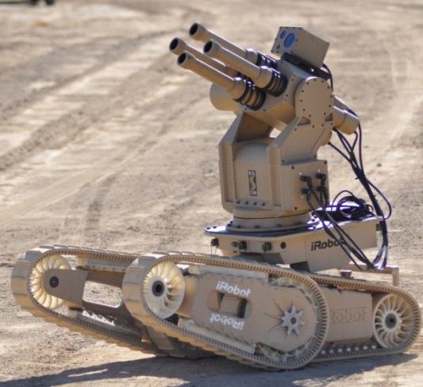
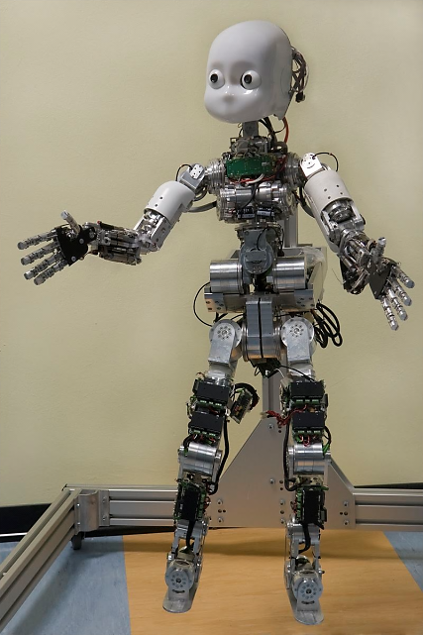
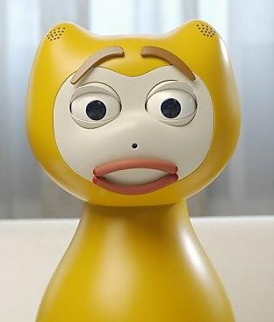
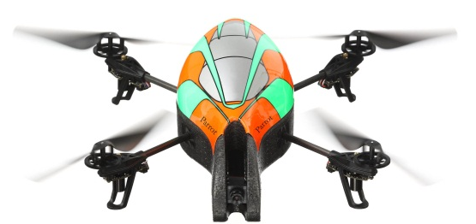
Effectors
Basically, anything to manipulate our world
Mobile: wheels, track, leg
Action: legs, grippers, head, facial action units, propeller
Temperature: heaters
Audio: speakers
Weapon: gun
Color: lights
Notes:
# slide 24 Effectors
{behavior|Twinkle}
{slide}\pau=1000\
When the processing unit has
{behavior|OneTheOther}
{behavior|LegRandomMove}
processed the input, a decision follows, which would usually mean.
{behavior|Clap}
I have to move parts of my body. This is done using effectors.
{behavior|Propose}
{behavior|Balance}
An effector is basically anything to manipulate our world, for example my arms, my legs, and my speakers, etcetera.
{behavior|PushAsideBoth}
Let's have a short look at what I can actually do with effectors.

Slide 21
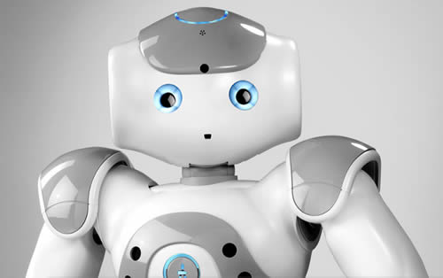
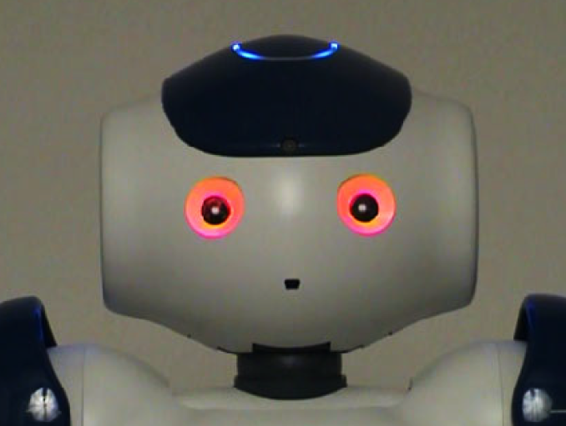
Head
Looking direction
Tracking face
Tracking sound source
Gaze
Show my attention
Head gesture:
nod
shake
dance
Eye LED Expression
Notes:
# Slide 25 Head
{behavior|Twinkle}
{slide}
\pau=1000\
{behavior|HandOver}
A head is probably, the most important part for humanoids. For me, despite that many important electronic components,
{behavior|ShowMic}
are inside my head. its movements also help me
{behavior|LookAround}
to track objects that interest me.
{behavior|LegRandomMove}
My gaze direction also indicates my attention.
{behavior|LegRandomMove}
Of course, head movements are essential to some gestures like
{behavior|Nod}
nodding and shaking head, and to dance.
# show blue, red
The lights in my eyes are also useful
{behavior|Wink}
for showing emotions.
\pau=2000\

Slide 22
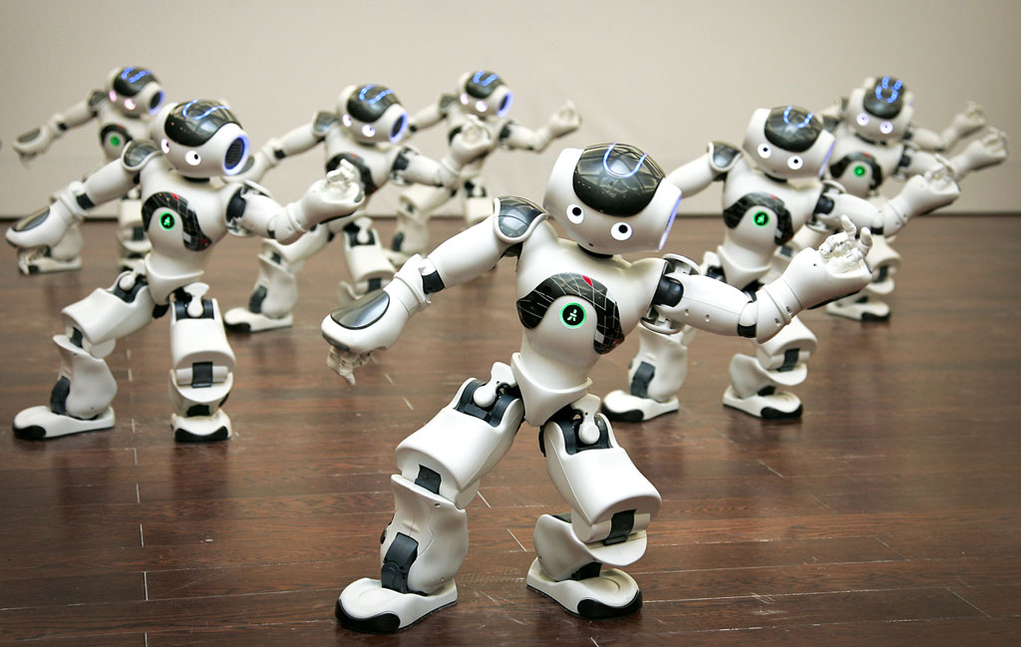
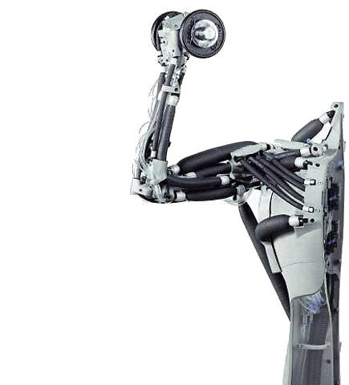
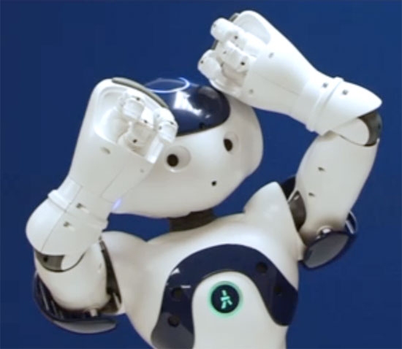
Arm
Grab objects
Gesture
Support body when standing up from a sitting position
Soccer: goal keeper
Dance
Game
Notes:
# Slide 26 arms
{behavior|Twinkle}
{slide}\pau=1000\
{behavior|LegRandomMove}
{behavior|Me}
One of my important effectors is my arm.
{behavior|Capisce}
Although I only have three fingers for each hand, I can still grab objects.
{behavior|RotatingCapisce}
I can also use my arms to make gestures.
{behavior|LegRandomMove}
When I need to stand up, my arms also help me to support my body.
{behavior|Clap}
Arms are also necessary for entertainment like soccer, dance, and games.

Slide 23
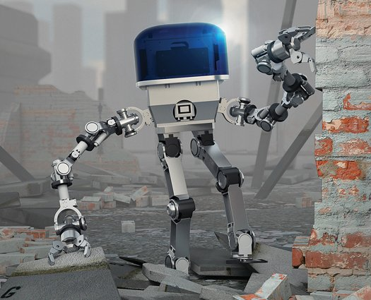
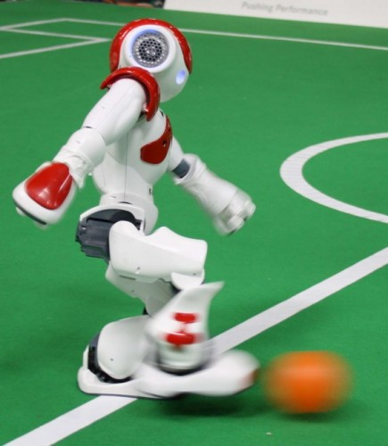
Leg
Stand
Move around
Jump
Play soccer: goal
Dance
Notes:
# Slide 27 leg
{behavior|Twinkle}
{slide}\pau=1000\
{behavior|Propose}
Legs are a representative feature for biped robots like me.
{behavior|LeanRight}
They support our body, enable us to stand, walk, and jump.
{behavior|Propose}
{behavior|LegRandomMove}
Legs have advantages in walking over complex terrains, where wheels can be easily stuck,
{behavior|HandOver}
{behavior|LegRandomMove}
for example, ruins caused by disasters.
{behavior|Spread}
However, compared to wheels, it is not easy to control my move accurately.
{behavior|LegRandomMove}
This is caused by the backlash of my joints and the slippage of my feet.
{behavior|HandOver}
{behavior|LegRandomMove}
As you might notice, I have been already standing at
{behavior|OneTheOther}
{behavior|LegRandomMove}
a different position, from where I started the lecture, although my leg movements were small.
{behavior|SpreadBoth}
As a result, it is difficult to control me to walk in a straight line.
{behavior|PushAsideLeft}
Legs are also important for entertainment.
Look at me! I am going to show you how I can stand on one leg, and, kick.
{behavior|Kick}
\pau=10000\
If my friends were here,
{behavior|Applaud}
I could even play soccer or dance with them.
\pau=500\

Slide 24
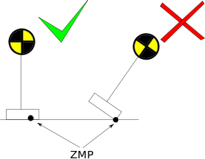
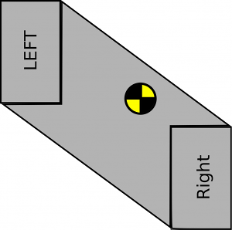
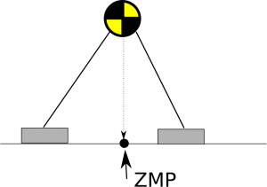
Body Balance - Zero Moment Point (ZMP) & Support Polygon
Zero Moment Point
A point where the total of vertical inertia and gravity forces equals zero
The center of pressure
Support Polygon
For me is the convex hull of my two feet
CoM must be inside the support polygon
Center of mass
(CoM)
Support
Polygon
Notes:
# Slide 28 - ZMP Support Polygon
{behavior|Twinkle}
{slide}\pau=1000\
{behavior|Balance}
Balence is a key aspect to the locomotion of biped robots.
{behavior|MeAndYou}
{behavior|LegRandomMove}
Let me introduce to you, some basic concepts of controlling my balance.
{behavior|Capisce}
{behavior|LegRandomMove}
The Zero Moment Point, Z M P, is the point on the robot feets, where the moments acting on the robot
{behavior|Weigh}
are balanced by an opposing moment from the ground.
{behavior|LegRandomMove}
{behavior|State}
If the Z M P is at the edge of the foot area or beyond it, the foot will tip over, and likely fall.
{behavior|LegRandomMove}
{behavior|HandOver}
To be simple, the support polygon of a robot is the convex hull of the footprints on the ground.
{behavior|ConvergeHands}
Under zero acceleration conditions, to keep the Z M P within the foot area, the center of mass of the robot body,
{behavior|LegRandomMove}
should be kept inside the support polygon,
{behavior|Capisce}
and if so, the robot will not rotate about the edges of the foot,
{behavior|ShowBody}
and will remain upright.
\pau=1000\

Slide 25



Walking Balance - Keep CoM Inside Support Polygon
ZMP
ZMP is moving during walking
Always keep CoM inside the support polygon during walking
CoM Path
Abstraction
Inverted pendulum cart
Linear Inverted Pendulum Model (LIPM): restrict the robot motion to the X-Y plane and prevent motion in the up down direction
Notes:
# Slide 29 - ZMP Support Polygon
{behavior|Twinkle}
{slide}\pau=1000\
{behavior|LegRandomMove}
In this slide, I will talk about balance during walking.
{behavior|Propose}
When I am walking, I select the next step very carefully.
{behavior|LegRandomMove}
to guarantee the Z M P of my body always inside the support polygon. As you can see,
{behavior|Walk}
my steps are small, and unlike a human.
\pau=1500\
{behavior|HandOverLeft}
{behavior|LegRandomMove}
More sophisticated walking style requires more complex algorithms, to keep the Z M P inside the support polygon.
{behavior|ProposeLeft}
{behavior|LegRandomMove}
One method is to model the locomotion of each leg, as an inverted pendulum cart, since most of the mass
{behavior|ShowBody}
aggregates in my upper body.
\pau=800\
{behavior|Capisce}
{behavior|LegRandomMove}
A widely used model is linear inverted pendulum mode, which constrains the motion of my body to the X Y plane.
{behavior|ConvergeHands}
Achieving position control of legs while making sure that, the Z M P is inside the foot area
{behavior|SpreadBoth}
{behavior|LegRandomMove}
is a whole research field on its own, so I will not provide further details in this lecture.
# summary
{behavior|Clap}
{behavior|LegRandomMove}
This is just what I can do with my effectors though, there are even robots that can juggle or play ping pong.
{behavior|No}
but I can not react fast enough.
{behavior|ShowBiceps}
{behavior|PushAsideBoth}
As you see, motors are not the only effectors that exist, but for me and most robots they are the most important ones, as they are essential to the movements of my body.

Slide 26


Degree of Freedom
A free object has 6 DOFs
3 DOFs of Translation (x, y, z)
3 DOFs of Rotation (pitch, yaw, roll)
Joints reduce DOF; bars cannot move freely
Limited by degrees of freedom (DOF)
No Wrist Yaw, Wrist Pitch
Only two joints (DOFs) for neck (head)
No waist joints
Fingers are coupled: only 1 active DOF!
Notes:
# Slide 30 - DOF
{behavior|Twinkle}
{slide}\pau=1000\
{behavior|YouAndMe}
{behavior|LegRandomMove}
Your arms and mine too, are limited by what we call degrees of freedom.
{behavior|Capisce}
A free object has six degrees of freedom, three for moving, and three for rotation.
{behavior|Convince}
{behavior|LegRandomMove}
A linkage, like my arm, is formed by several bars connected by joints.
{behavior|HandOverLeft}
Joitns reduce degrees of freedom, because the bars cannot move freely anymore.
{behavior|LegRandomMove}
They can only rotate around the joints. Take your wrist for example.
{behavior|LRUD}
You can rotate it up and down, left and right, and twist it, giving it three degrees of freedom.
{behavior|No}
{behavior|LegRandomMove}
My arm has even less degrees of freedom, because only some joints can rotate around three axes.
{behavior|CapisceLeft}
Some of my joints, like the three fingers of my hand, are controlled
{behavior|Tiny}
by only one motor, so it only has one degree of freedom.

Slide 27

DOF Quiz Answer
Elbow Roll
Shoulder Roll
Wrist Yaw
Shoulder Pitch
Elbow Yaw
Finger
Notes:
# Slide 32 DOF answer
{slide}
\pau=500\
# better words?
{behavior|LegRandomMove}
{behavior|ShowArmJointsOneByOne}
Since my shoulder, can pitch, and, roll.
\pau=400\
my elbow, can roll,
\pau=300\
and yaw.
\pau=700\
{behavior|LegRandomMove}
my wrist, can only yaw.
\pau=2000\
and I have told you my fingers only have one degree.
\pau=2000\
{behavior|LegRandomMove}
{behavior|State}
This gives it a total of 6 degrees of freedom.
\pau=500\

Slide 28


Programming
Choregraphe
Graph-flow based programming
Modular behaviors that can be called locally and remotely
Simulator
Notes:
# Slide 33 Programming
{behavior|Twinkle}
{slide}\pau=1000\
{behavior|Clap}
{behavior|LegRandomMove}
Now we have seen what I can do, with my sensors and effectors,
{behavior|Me}
let me give you a brief introduction to how you can program me.
{behavior|SpreadBoth}
Choregraphe is an excellent graph-flow based programming tool shipped with me.
{behavior|FromAToB}
{behavior|LegRandomMove}
You can drag boxes from libraries, and connect them to create your projects, as you can see on the right of the slide.
{behavior|Propose}
{behavior|LegRandomMove}
This type of programming is also called visual programming.
{behavior|OneTheOther}
{behavior|LegRandomMove}
Sometimes, you may need to change the code behind the boxes, or create your own boxes.
{behavior|HandOver}
{behavior|LegRandomMove}
You can use Python to code these boxes. Projects can be executed on a computer, and on the robot.
{behavior|PointRight}
Sometimes, actions you create might cause me to fall down.
{behavior|LegRandomMove}
It is therefore very useful that, there are also simulators available for a try-out.

Slide 29
Programming languages
C++
AL::ALTextToSpeechProxy tts("<IP of your robot>", 9559);
tts.say("Hello world from c plus plus");
Java
ALTextToSpeechProxy ttsProxy = new ALTextToSpeechProxy("<IP of your robot >", 9559); tts.say("Hello World from java");
Python
tts = ALProxy("ALTextToSpeech", "<IP of your robot>", 9559) tts.say("Hello world from python")
URBI
tts.say("Hello World from urbi")
Notes:
# Slide 34
{behavior|Twinkle}
{slide}\pau=1000\
{behavior|PushAsideBoth}
{behavior|LegRandomMove}
A-P-I's to the A L modules provided with Nao Qi framework, are available for customized applications.
{behavior|State}
This slide shows an example of text to speech module.
{behavior|HandOver}
{behavior|LegRandomMove}
You can also use various programming languages, including c plus plus, java,

Slide 30
Programming languages
Matlab
tts = ALTextToSpeechProxy('<IP of your robot>', 9559); tts.say('Hello World from matlab');
C#
TextToSpeechProxy tts = new TextToSpeechProxy("<IP of your robot>", 9559); tts.say("Hello World from c sharp");
VB
Dim tts As TextToSpeechProxy = New TextToSpeechProxy("<IP of your robot>", 9559) tts.say("Hello World from visual basic")
F#
let tts = new TextToSpeechProxy("<IP of your robot>", 9559) tts.say("Hello World from f sharp")
Notes:
# Slide 35
{slide}
\pau=500\
{behavior|LegRandomMove}
c sharp, and even matlab to create your applications. They are all supported by our SDK libraries now.
{behavior|Propose}
{behavior|LegRandomMove}
However, only c plus plus and python are supported by the Linux system on the robot.

Slide 31


Robotutor Project
Script engine on the robot
Flexible script
Capable to run independently
Multimedia access
PowerPoint slide control
Classroom speaker
Interact with students
Respond to answers
Physical interaction
Script
interaction
Control flow
Data flow
If you are interested
Contact: k.v.hindriks@tudelft.nl
Notes:
{behavior|LegRandomMove}
{behavior|Me}
Finally, I will briefly introduce the Robo Tutor project.
\pau=1000\
{behavior|First}
Thanks to the script engine, that is part of my system,
{behavior|LegRandomMove}
{behavior|SpreadBoth}
many different scenarios can be designed for me to perform.
{behavior|YouAndMe}
{behavior|LegRandomMove}
Right now, I am a robot tutor, teaching you about robotics. However, I can also act in a theater, using the same system.
{behavior|Spread}
{behavior|LegRandomMove}
As you can see on the left bottom of the slide, the script is very intuitive.
{behavior|Propose}
{behavior|LegRandomMove}
With such a script, you can easily orchestrate my speech, actions, slide control, et cetera.
{behavior|LegRandomMove}
{behavior|SpreadBoth}
But don’t forget, I also need behaviors that need to be created, and synchronized with my speech, and the other actions that I perform. There are several concurrent threads, that need to be managed!
{behavior|LegRandomMove}
{behavior|OneTheOther}
Scripts can be stored both on a computer or in my system,
{behavior|Me}
{behavior|LegRandomMove}
and I can act using a script in my system,
{behavior|PushAside}
without another computer.
{behavior|LegRandomMove}
However, at least for now, a computer
{behavior|Propose}
is required for the slides and quizzes.
{behavior|LegRandomMove}
{behavior|Clap}
Thanks to the turning point technology, I can check,
{behavior|YouAndMe}
{behavior|LegRandomMove}
how well you understood the content I just taught,
{behavior|HandOver}
{behavior|LegRandomMove}
and provide more explanation on things, that were not clear.
{behavior|State}
{behavior|LegRandomMove}
My voice can also be transferred to a computer, and amplified, using the classroom speakers.
{behavior|ShowBody}
{behavior|LegRandomMove}
I am still growing. More and more functions will be added to me.
{behavior|Applaud}
{behavior|LegRandomMove}
Plans are for me to interact more and, for example, answer open questions that students ask directly, using a question-answer system.
{behavior|LegRandomMove}
{behavior|YouAndMe}
If you are interested in this project, please contact my boss, Koen Hindriks.

Slide 32

Thank you for your attention!

